Slide 2
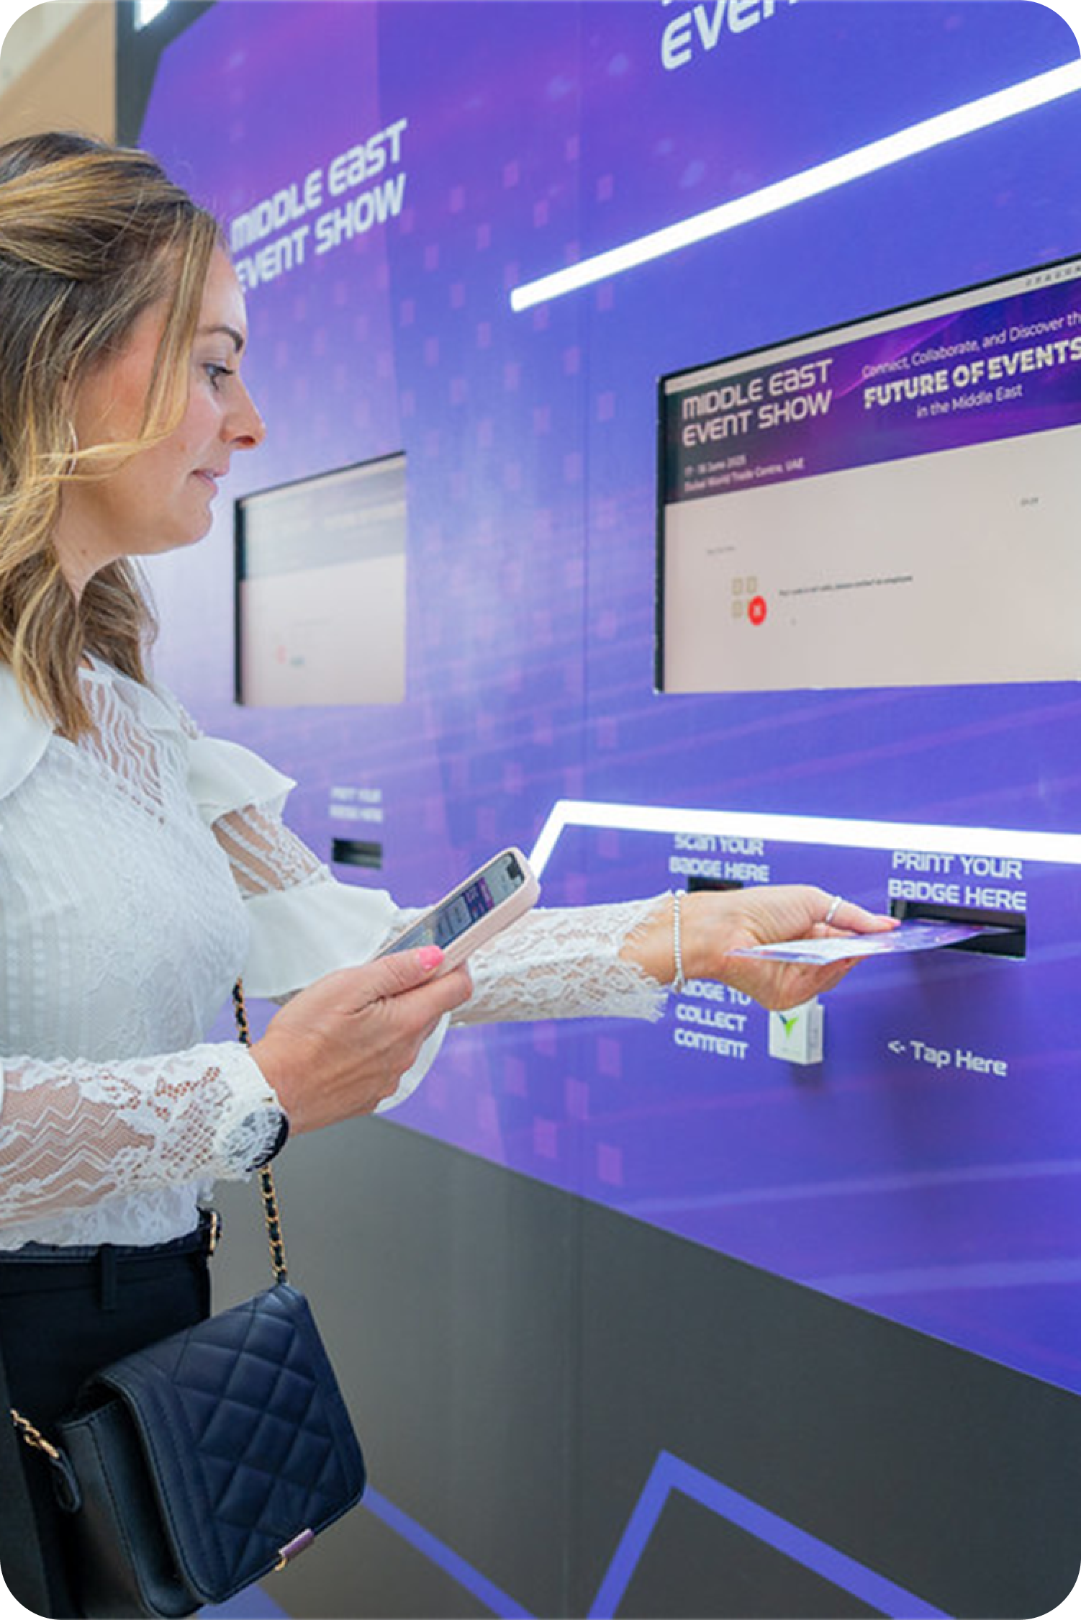
Welcome to a Smarter Onsite Experience
Whether you're managing attendee access, badge printing, or access control, we provide reliable, pre-configured devices that integrate seamlessly with Visit.
All hardware is tested, event-ready, and supported by our team to ensure a smooth onsite experience.

Slide 3
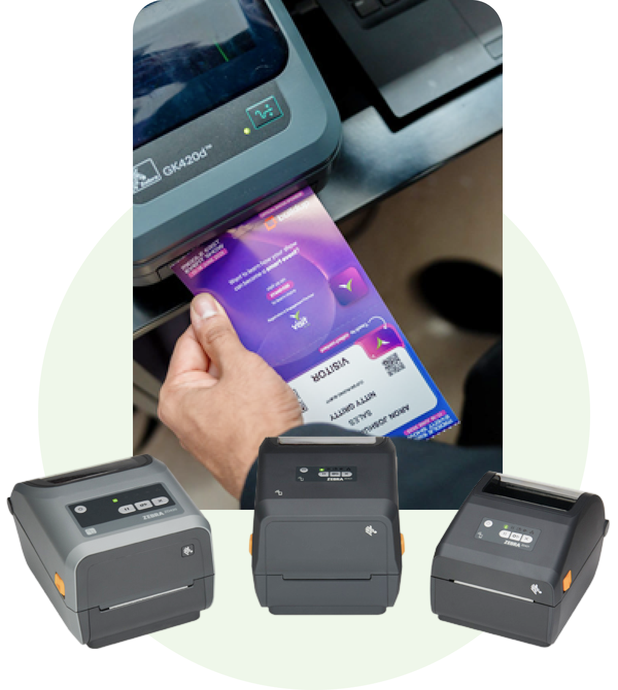
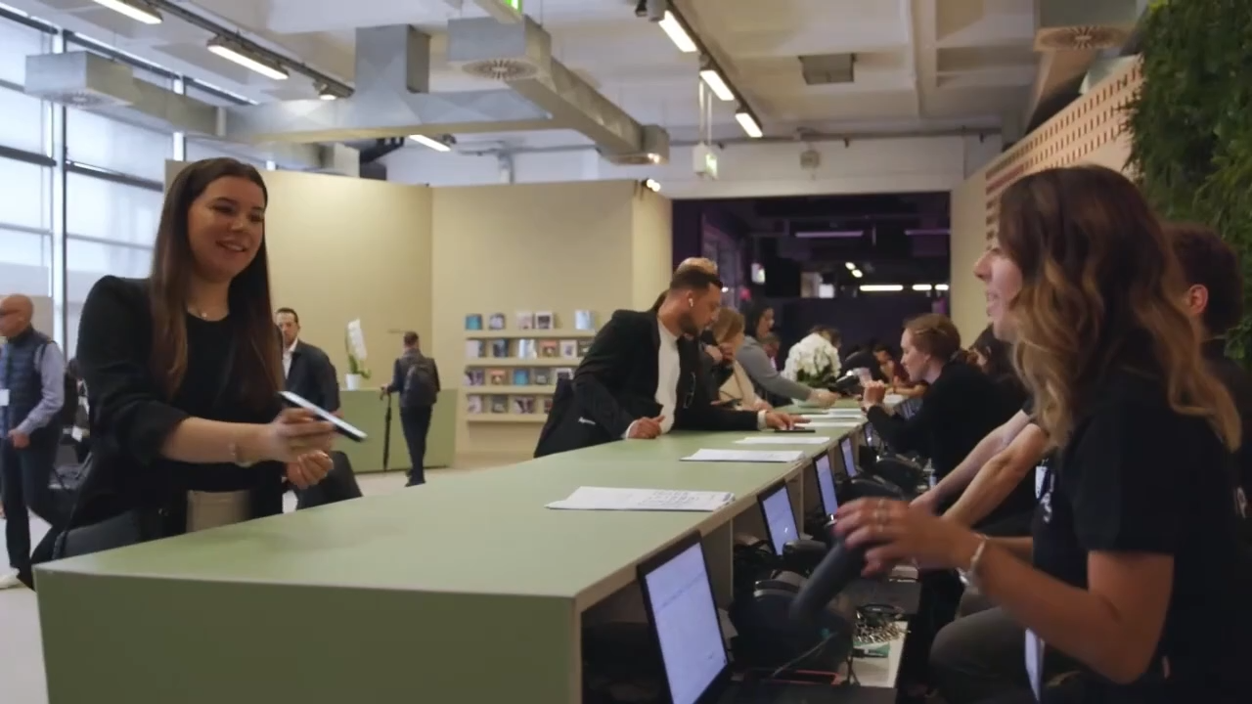

Registration & Badge Printing
DEVICES
SEE THEM IN ACTION
Zebra ZD421D / ZD621 / GK420D
Thermal printers
USB or Network connection
Laptop required
USED FOR
Badge printing with Visit Check-in
FEATURES
High-speed thermal printing, sustainable, durable

Slide 4
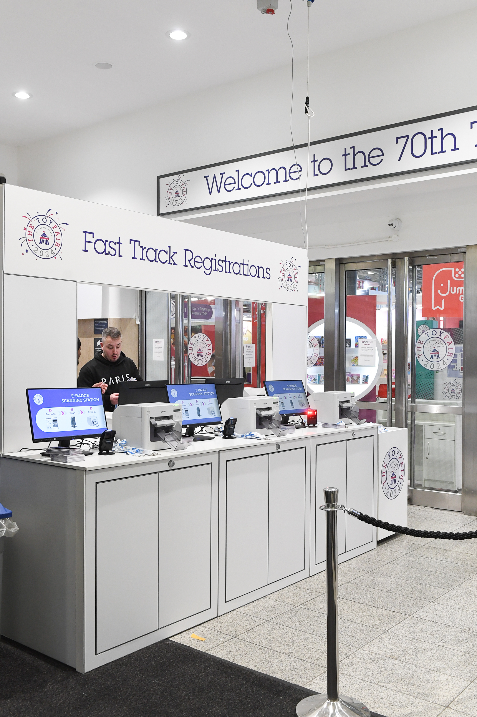
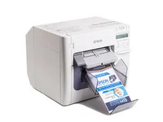
Registration & Badge Printing
DEVICE
Epson TM-C3500
Inkjet technology
USB or Network connection
USED FOR
Badge printing with Visit Check-in
FEATURES
Full-colour, high-speed printing, sustainable, durable

Slide 5
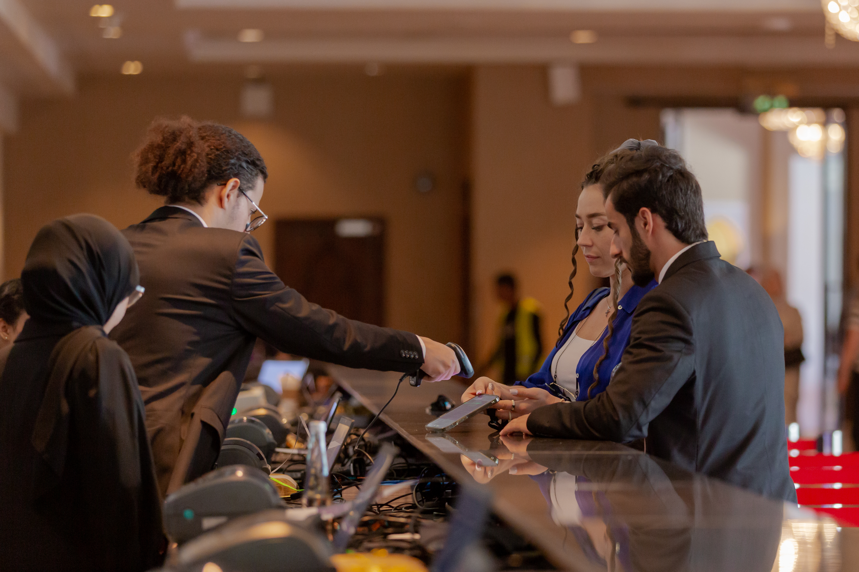
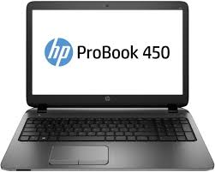
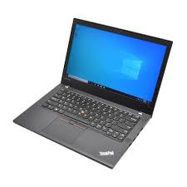
Registration & Badge Printing
DEVICES
HP ProBook 450 G3 i7-6500U, Lenovo ThinkPad T470s – Intel Core i7
USB or Network connection
Multiple USB ports
USED FOR
Badge printing, access control, Scan & Go with Visit Check-in
FEATURES
Strong processor performance, portability, reliability

Slide 6
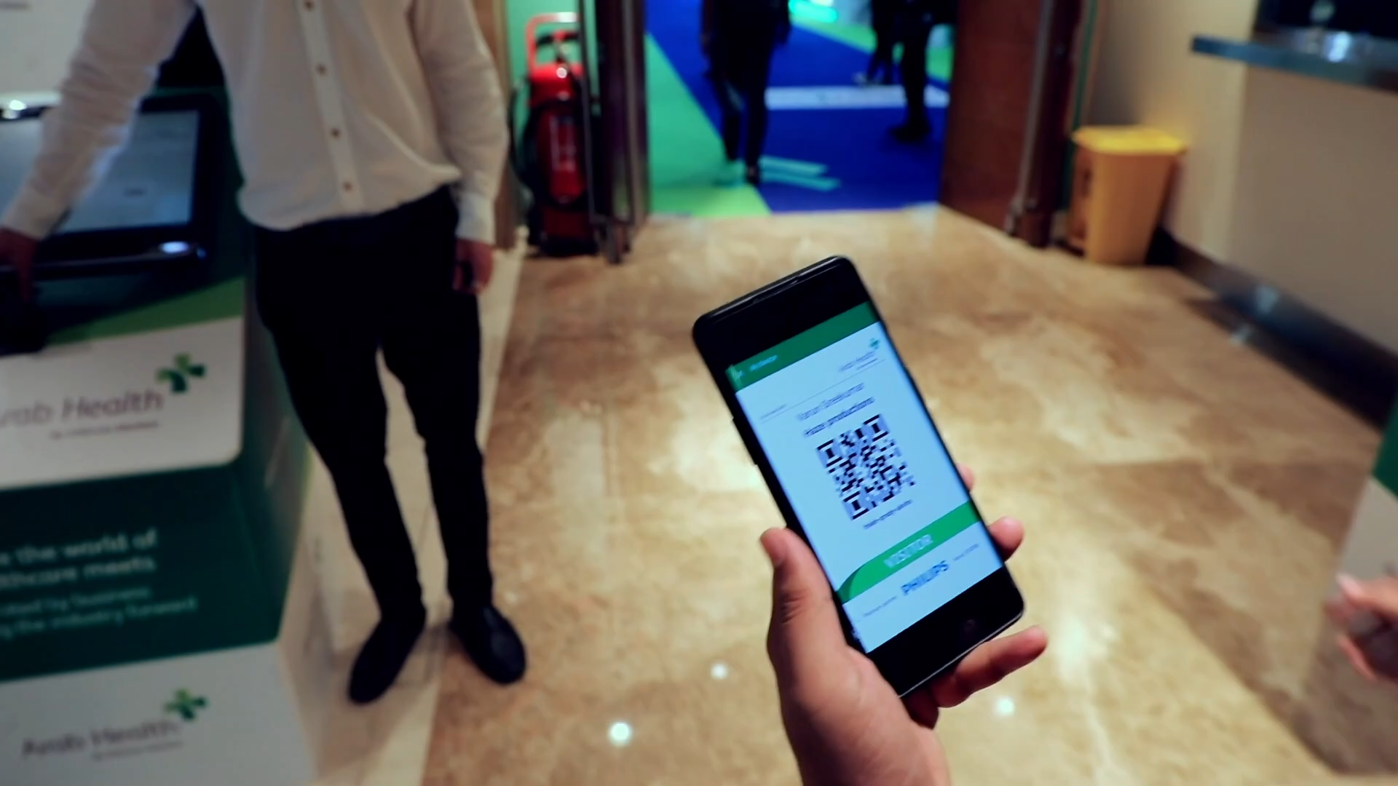
Check-in & Scan & Go
HOW THEY WORK
DEVICES
Opticon L-46X, Opticon M-10, Zebra DS9208
Laptop required
USB connection
USED FOR
Access control, Scan & Go with Visit Check-in
FEATURES
Quick, accurate, plug-and-play

Slide 7
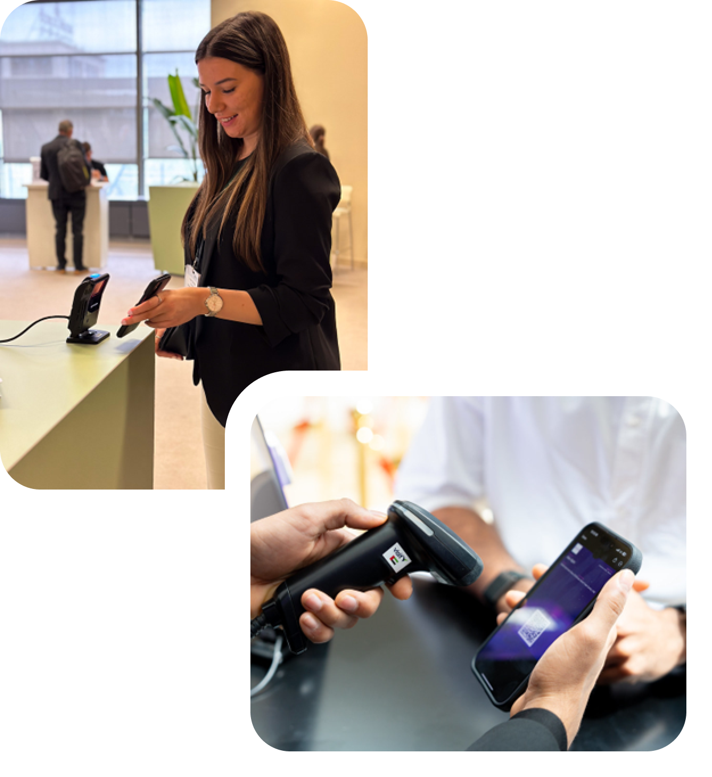
Access Control
DEVICES
Opticon L-46X, Opticon M-10, Zebra DS9208
Laptop required
USB connection
USED FOR
Access control, Scan & Go with Visit Check-in
FEATURES
Quick, accurate, plug-and-play

Slide 8
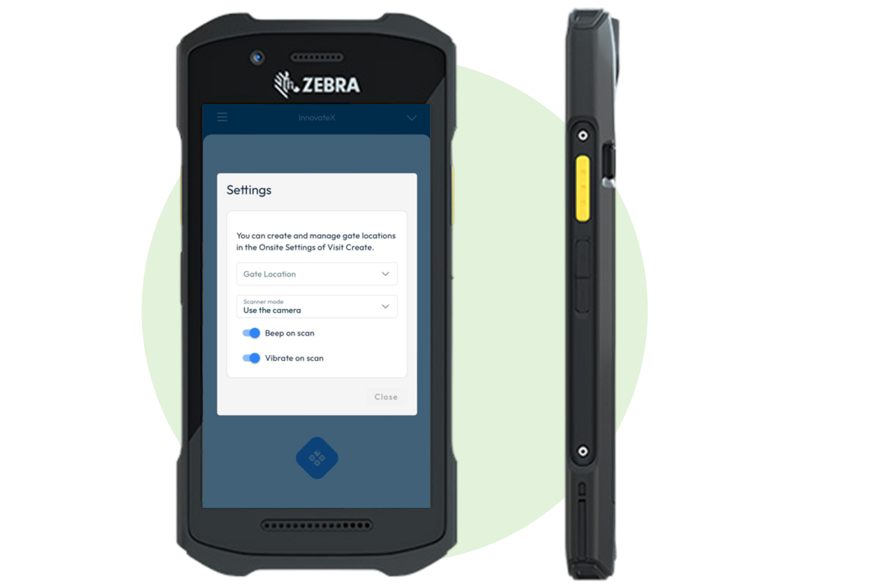
Access Control
DEVICE
Zebra TC26 Smart Scanner
Wi-Fi connection required
No laptop required
USED FOR
Access control with Visit Check-in Lite
FEATURES
Touchscreen Android, Integrated QR scanner

Slide 9
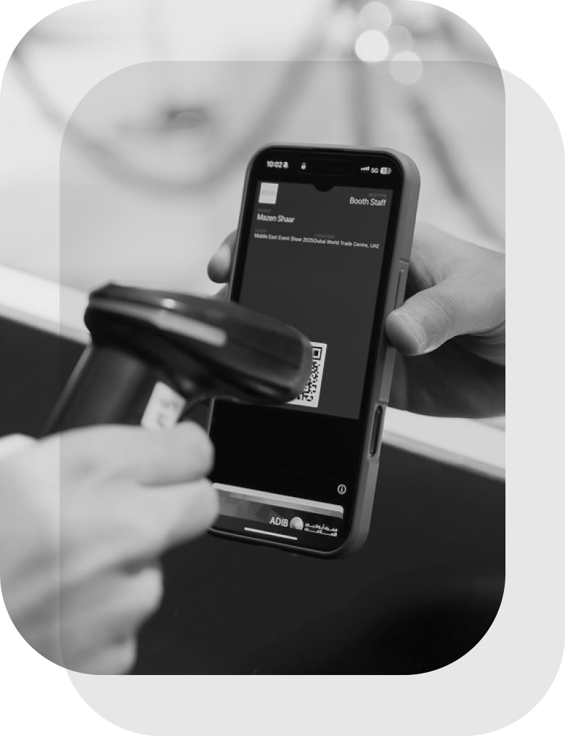

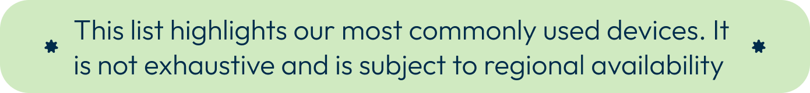
Event-Ready Hardware & Support
ALL DEVICES ARE
Fully tested and pre-configured for Visit
Delivered and collected with logistics handled by Visit
Supported remotely or onsite by our technical team
LEAD TIME
Place your order at least 4 weeks before your event
WE’RE HERE TO HELP
Need a large-scale setup or custom bundle? Reach out to your Visit account manager.

