Slide 1
Executive Summary
Partnership
Commercials
Compliance
Demos & Workflows
Contact
Client & GES Event Intelligence
RFP RESPONSE, 8 JUNE 2023

Slide 2
Executive Summary
Partnership
Commercials
Compliance
Demos & Workflows
Contact
Executive Summary
Strategy & RFP Highlights
Company History

Slide 3
Executive Summary
Partnership
Commercials
Compliance
Demos & Workflows
Contact
EXECUTIVE SUMMARY
Strategy & RFP Highlights
Visit by GES: Mission – Powering events. Empowering people.
RFP Highlights
4 Visit Evolution - Registration + Manual + Engagement + Community + Re-Booking
4 Your Choice - Visit End 2 End or Visit + (Embed Mode)
4 Globalise - Save 15%
4 Right 1st Time - FOC Pilots
4 Smart Show Floor - NFC Touchpoint Only £50 per booth
Art and science are equally essential ingredients when conceiving any successful event. And with Visit, CLIENT can harness both as spaces are transformed, in both the physical & digital realms, into dynamic places of engagement, discovery and inspiration.
With Visit, CLIENT will:
4 Be able to prepare, create, execute, monitor, affect and measure event success, end to end
4 Have full control over your data, brand and participant experiences
4 Be able to digitise, optimise and monetise customer success
4 Empower teams to self-serve, as desired, whilst ensuring consistency and compliancy
4 Be able to integrate and automate as you scale globally
4 Have myriad data insights to enhance value and foster customer loyalty
4 Utilise the platform’s modular capabilities to minimise cost
4 Better serve communities, year round
With Visit you’re not just staging an event, you’re building a community.
2,100 +
Events
67 +
Countries
5.1 M +
Registrations
3.2 M +
Attendees
326,000 +
Exhibitors
YEAR IN REVIEW
2022

Slide 4
Executive Summary
Partnership
Commercials
Compliance
Demos & Workflows
Contact
EXECUTIVE SUMMARY
Company History
Transition to Online registration
Acquired by P&O Exhibition Services
Transition Self service CX on arrival
Transition SaaS
Transition Global support (EU, HK, UAE, US)
Transition PWA powered CXs
Transition Plug & Play ‘welcome experience’
1992
2012
2017
Transition Digital badge
Acquired by GES
Founded in the UK
1999
Merged with N200 NL
2014
Acquired Poken
Transition Lead gen via native apps
Transition NFC powered visitor engagement
Transition Advanced API
Transition eBadge/ ticket
Transition AWS Ireland, 99.8% uptime
Transition to Event Engagement Platform

Slide 5
Executive Summary
Partnership
Commercials
Compliance
Demos & Workflows
Contact
CLIENT & GES Event Intelligence
CLIENT & GES Event Intelligence - a Partnership
Global SaaS solution. Local support. Keeping Pace With Change (part 1 & part 2) Platform Evolution (part 1 & part 2)
Visitor Journey Exhibitor Journey Organiser Journey

Slide 6
Executive Summary
Partnership
Commercials
Compliance
Demos & Workflows
Contact
CLIENT & GES EVENT INTELLIGENCE
CLIENT & GES Event Intelligence - a Partnership
At GES, we are proud of our long association with CLIENT and, in particular, our collaboration to ensure we emerged stronger following the COVID hiatus. Now, we are excited by the prospect of refreshing our partnership and, together, shaping the future in an ever-changing landscape.
Our commitment
2022 CLIENT & GES
INNOVATION
Visit’s product development goals will align with your strategic vision
INTEGRATION
You decide how Visit fits into your global eco-system. Real time. Every time.
STANDARDISATION
You are in control. Your data. Your taxonomy. Your templates. Your rules
ADOPTION
Click & Go, powered by progressive web or native apps. Personal experiences at a time and place of your participant’s choosing.
SATISFACTION
You choose where, what, when. Our plug & play, modular approach guarantees flexibility and affordability.
426 | 1.7M+ | 883k+
events held | registrations | attendees
29k+ | 614k+ | 560M+
partners | leads | api calls

Slide 7
Executive Summary
Partnership
Commercials
Compliance
Demos & Workflows
Contact
CLIENT & GES EVENT INTELLIGENCE
Global SaaS solution. Local support.
4 Your data, your brands, your communities
4 Consistent, compliant, scalable CXs
4 Plug & play, out of the box
4 Pay As You Go
4 DIY or managed service
4 Any currency, any language, anywhere
4 Local hardware and technician delivery partners
4 24/7 emergency support
Oneworldrental
Hamiltons
Allrent
Choose2Rent Meeting tomorrow
Viablesoft Solutions
Ads plus plus
Expotec
One World Rental Events Tech Eventware rental
Eventsrail
Choose2Rent
Cidtech
Gorentals
One World Rental Choose2Rent
Visit by GES & Partners - More than a network. It’s a team.

Slide 8
Executive Summary
Partnership
Commercials
Compliance
Demos & Workflows
Contact
CLIENT & GES EVENT INTELLIGENCE
Keeping Pace With Change
PART 1
Visit – a platform you can trust
For 30 years, Visit has kept pace with change, enabling clients to embrace technological advances to optimise experience and minimise cost. Without doubt, COVID accelerated significant change in our industry, initially, how to stage events virtually. Then, how to resume live events safely. And now, how to deliver success to participants in a world where ‘blended’ working practices are enduring. Where an event is no longer constrained by time or place. And where digital CXs are common place.
In response, we at GES have been busy! As you can see (overleaf) , much has been achieved over the last 3 years – from COVID Secure measures to a whole new suite of engagement tools. And from ‘click & go’ PWAs to a CMS powered Exhibitor Directory.
Our development velocity is, in no small part, possible because Visit’s system architecture is modular, meaning that new functionality can be easily added to the solid foundations beneath. These foundations, proven in live environments where the show ‘simply must go on’ are the bed rock that will continue to enable Visit to stay at the cutting edge – delivering innovative solutions that can be used anywhere, any time.
Predictive & Relevant
Seamless & On Demand
Interactive & Personal

Slide 9
Executive Summary
Partnership
Commercials
Compliance
Demos & Workflows
Contact
Keeping Pace With Change
Platform enhancements, last 3 years
CLIENT & GES EVENT INTELLIGENCE
PART 2
for organisers
for exhibitors
for visitors
4 New UI/UX
4 Enhanced security with 2FA
4 Enhanced accounts with a wide selection of roles and an extended permissions list
4 Advanced management of partners and content
4 GDPR compliancy
4 Shop - improved shop and wider choice of PSPs
4 Advanced reporting
4 Engagement tools: Sharing & Streaming, Agenda, Sponsorship, Notifications, Directory, Matchmaking, Networking
DATA
4 Data validation
4 Photo validation
4 New JSON API with a myriad of data points for seamless integrations
4 Co-located events reporting
ACCESS CONTROL
4 New mobile check in system - Check-in Lite 4 Improved existing Check in system 4 Contactless check-in
4 Co-located events - access to multiple events with a single registration > seamless experience
4 Timeslots
4 Capacity management with camera tracking, time slots and notifications
4 COVID 19 secure
4 Merge of Visit Partner with Visit Connect
4 Visit Connect PWA - progressive
web application
4 Digital badge
4 Multilayer Visit Connect access
4 Content QR codes
4 Easy, secure, log in free access
4 Embed Mode
4 Engagement tools: Sharing & Streaming, Agenda, Sponsorship, Notifications, Directory, Matchmaking, Networking
4 Visit Discover PWA - progressive web application
4 Digital badge
4 Easy, secure, log in free access
4 QR codes content collection
4 Multi-event access
4 Engagement tools: Sharing & Streaming, Agenda, Sponsorship, Notifications, Directory, Matchmaking, Networking
Scalable
Mirrored Services, 3 facilities in Ireland
Uptime 99,9%
Page load average <1 second
CloudFront

Slide 10
Executive Summary
Partnership
Commercials
Compliance
Demos & Workflows
Contact
CLIENT & GES EVENT INTELLIGENCE
Platform Evolution
PART 1
Registration + Engagement + Event Management + Community 365
Visit end/end or Visit +?
Or, if you prefer to use a 3rd party platform to power your participant engagement then our Embed Mode is the answer – enabling you to harness the power of Visit’s registration tools, seamlessly, within a 3rd party CX.
Visit is evolving. Building upon its proven registration engine, the platform now offers a rich suite of new modules designed to enable participants to better prepare for and tailor their event experience, Intuitive tools via ‘click & go’ links empower them to fully engage with your brand, beyond the show floor, and each other.
What’s next?
Our product vision is clear – some simple architecture modifications will enable users to group related events into portfolios, creating community hubs where anyone on your central database can be invited to join, engage, network and consume available content and resources. Our Community module is targeted for launch in H1 2025.
Connect (exhibitor UI) and Discover (visitor UI)
can be configured to suit your ‘smart’ event goals, turning modules on/off with ease. Whether you wish to offer a fully immersive experience or a lite touch, your Visit Create UI puts you in control – of your brand, your event and your value proposition.
Prior to that, we are now busy building our new Prepare module (launch planned H1 2024), designed to enable users to create Exhibitor Manuals from pre-configured clone templates. Once ready, exhibitors will access your event manual from their Connect UI, giving them all the tools they need, in one place, to fully prepare for, plan, monitor, affect and measure their success!

Slide 11
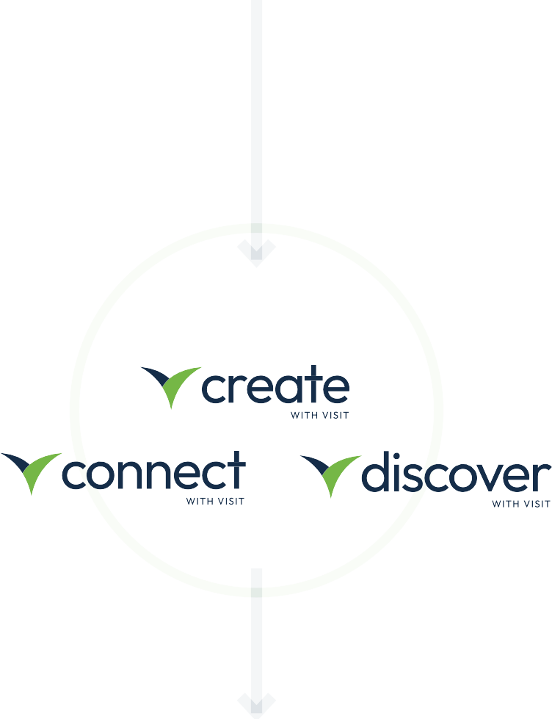
Executive Summary
Partnership
Commercials
Compliance
Demos & Workflows
Contact
CLIENT & GES EVENT INTELLIGENCE
Platform Evolution
PRODUCT VISION - PAST, PRESENT, FUTURE
PART 2
Organisation Level
Clone templates, data taxonomy, API
config, user mgt, compliance
Central Database / SCV
Registrants / Data Subjects
Consistent & Scalable
4 Real-time
4 Offline Mode
4 Any Language
4 Any Currency
4 Global Deployment
4 DIY & Managed Services
4 365/24-7 On Call
ECOSYSTEM
Gated CMS – Free to View / Log In / Pay to View
Organiser Event Silo Organiser Portfolio Silo
Proven, since 1992 Registration Platform
Now Engagement Platform
Next Exhibitor Manual
Then
Community Platform
Community Hub
AI

Slide 12
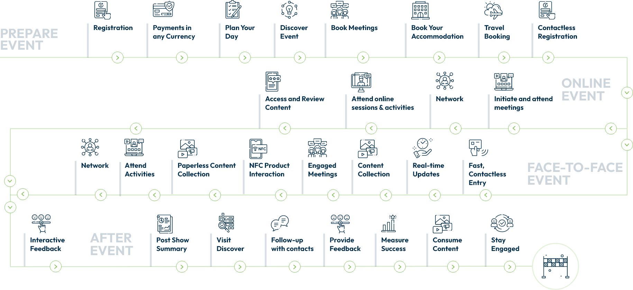
Executive Summary
Partnership
Commercials
Compliance
Demos & Workflows
Contact
CLIENT & GES EVENT INTELLIGENCE
Visitor Journey

Slide 13
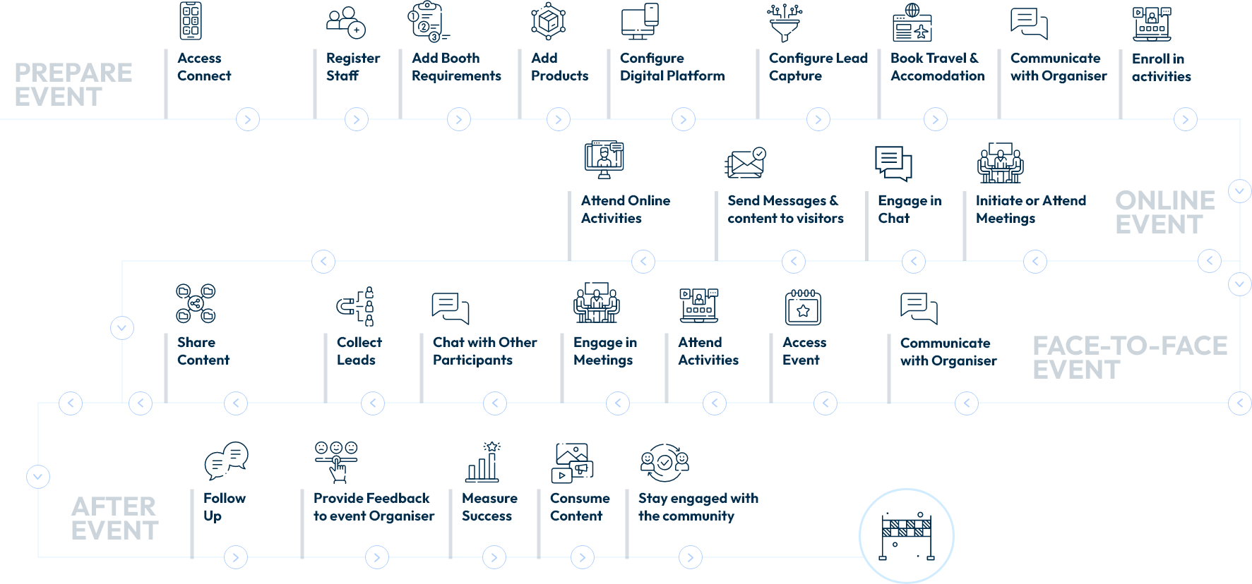
Executive Summary
Partnership
Commercials
Compliance
Demos & Workflows
Contact
CLIENT & GES EVENT INTELLIGENCE
Exhibitor Journey

Slide 14
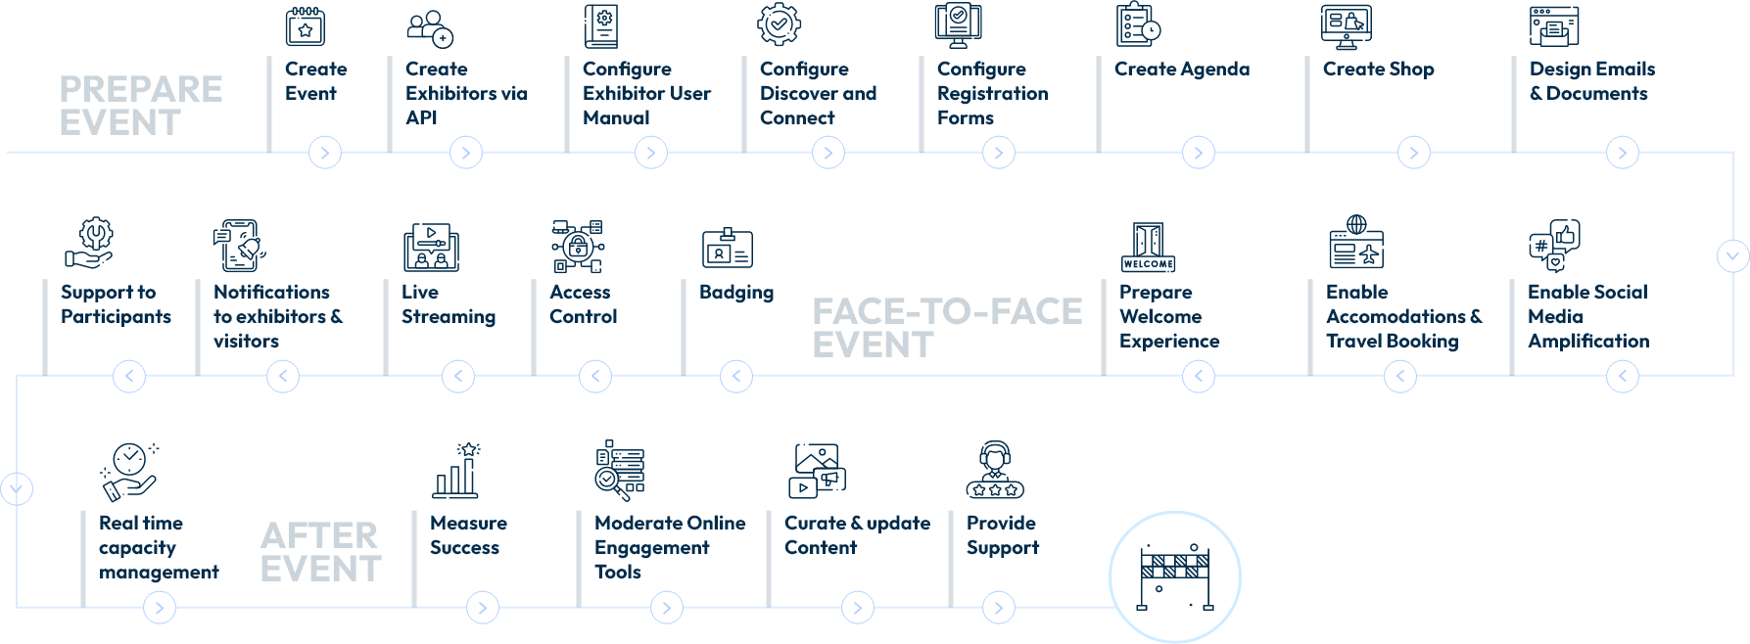
Executive Summary
Partnership
Commercials
Compliance
Demos & Workflows
Contact
CLIENT & GES EVENT INTELLIGENCE
Organiser Journey

Slide 15
Executive Summary
Partnership
Commercials
Compliance
Demos & Workflows
Contact
Commercials
Visit - flexible & affordable
Mix & Match - Visit End/End or Visit +

Slide 16
Executive Summary
Partnership
Commercials
Compliance
Demos & Workflows
Contact
Visit - flexible & affordable
Visit End/End: Registration + Manual + Engagement + Community + Re-Booking
OFFER HIGHLIGHTS
PAY AS YOU GO – INFLATION CAPPED
4 Emerging Markets tiers added XX
4 Scale globally and save XX
Events are no longer constrained by time or place. Participants expect to be able to engage with your brand and each other whenever, wherever and however they choose. And they demand that any interaction be personal, responsive and intuitive.
UNLIMITED API KEYS
4 Connect Visit to other platforms to optimise CX
ADD Prepare (Event Manual, from June 2024)
4 Only XX per partner
That’s why we’ve launched our suite of new engagement tools. To enable seamless experiences before, during and after your event or brand engagement. And these tools are modular by design, putting you in control of both CX and cost, event by event.
ADD ENGAGEMENT
4 Engagement Bundle only XX per partner (Developed Market)
4 Pilot Rate XX per bundle per partner. Saving XX (H2 2024 / H1 2025)
4 Pilot Rate before H2 2024 – FOC!
MIX & MATCH – ENGAGEMENT MODULES
VISIT – EMBED MODE
ADD SMART – add Real Time TouchPoint(s) per booth
4 Sharing & Streaming
4 Agenda
4 Sponsorship
4 Notifications
4 Directory
4 Lead Gen
4 MatchMaking
4 Networking
4 Community 365 ( from H1 2025)
Or, on occasion, you may prefer to use 3rd party platform(s) to deliver your optimal CX in concert with Visit’s registration tools only. In which case, our proven Embed Mode is the answer. Providing you
all the flexibility you require to mix & match as you deem appropriate. And remember, with our modular offering, you only pay for the tools you use!
4 Only XX per partner (Developed Market)
4 Additional RTTs XX each, per partner
ADD COMMUNITY (365, from January 2025)
4 Only XX per partner (TBC)
Please see a summary of our commercial highlights opposite. More detail can be found in our commercial model (Pricing Proposal)
3RD LINE SUPPORT
4 24/7
4 365
4 FOC

Slide 17
Executive Summary
Partnership
Commercials
Compliance
Demos & Workflows
Contact
Mix & Match - Visit End/End or Visit +
With Visit, CLIENT are in control. Modules can be activated event by event (Pay As You Go) to deliver your optimal CX end/end or, via our Embed Mode, with a 3rd party platform of your choice.
SCENARIO 1
Visit End To End
SCENARIO 2
Visit Embed Mode
3RD PARTY
3RD PARTY
Exhibitor Manual
FROM SUMMER 2024
Registration
Engagement
365 Community
FROM JANUARY 2025
Exhibitor Re-book
TBD

Slide 18
Executive Summary
Partnership
Commercials
Compliance
Demos & Workflows
Contact
Compliance
Compliance Matters
Environmental Stewardship

Slide 19
Executive Summary
Partnership
Commercials
Compliance
Demos & Workflows
Contact
Compliance Matters
GES understands the importance of data to Event Owners. How it builds community. How it drives value. How it shapes strategy.
Data is the lifeblood of your business. And as your data processor, GES takes its responsibility seriously, taking all necessary measures to safeguard it, manage it, maintain it.
A LETTER FROM OUR PRESIDENT
Viad Corp and its operating companies, located in North America, the United Kingdom, Europe and the United Arab Emirates, hold leading positions in the live events industry and travel and recreation industry.
Compliance is a key driver across the business. From cyber security to GDPR. From PCI to data privacy. And from 3rd party supplier accreditation to team training, GES invests heavily in continuous improvement initiatives to build trust and drive capability.
Our family of businesses shares a common goal — providing high quality, memorable experiences for a global audience.
In 2017, GES migrated our Visit platform to AWS, Ireland. Hosted across 3 separate facilities, all servers are mirrored, guaranteeing up time and continuity. GES also utilise AWS’ suite of security and scaling tools, meaning that your events and data can be easily accessed from anywhere in the world no matter the volume of traffic at any particular time.
We are proud to be an organisation with a long-standing commitment to the values of integrity, ethical behaviour and legal compliance.
These values are reinforced every day in our businesses through our Always Honest Compliance and Ethics Program, which was implemented in 1994. Every employee, officer and director of Viad and its operating companies is responsible for knowing, understanding and upholding these values.
We believe that maintaining a culture of high ethical and legal standards provides Viad with a distinct advantage in recruiting and retaining top talent, driving the best value for our customers and attracting shareholders who invest in Viad’s stock, which is traded on the New York Stock Exchange (NYSE: VVI).
In 2019, GES was proud to secure ISO 27001 (information Security) and PCI SAQ-A certification. In 2024, we will be working towards ISO 9001 (Quality Management).
Our reputation rests on each of us upholding these values every day with our customers, suppliers, competitors, local communities and with each other. Being Always Honest is at the very core of our corporate identity and guides everything we do.
Steve Moster
CHIEF EXECUTIVE OFFICER, VIAD CORP
Together, these workstreams will enable Visit by GES to deliver optimal, consistent, compliant and robust experiences, globally.
Across the group, GES’ Compliance Team shape and oversee best practice drivers and strive to ensure honesty and transparency across the business.

Slide 20
Executive Summary
Partnership
Commercials
Compliance
Demos & Workflows
Contact
COMPLIANCE
Environmental Stewardship - ISO 20121 certified
GES is a pioneer and passionate advocate of sustainable practice in the events industry.
We were one of the first to secure BS 8901 certification for event sustainability and have since achieved the stringent ISO 2012 international accreditation for our management systems.
Sustainability is at the heart of our operational strategy, informing decision making, guiding working practice and determining product and supplier selection.
HELPING YOU CREATE A LASTING IMPRESSION
4 First to offer online registration in the UK, signalling the end of postal and fax registration services and the mailing of badge packs
4 First to offer e-badges in the UK and Benelux region, reducing the number of
registration desks, terminals and printers required for the ‘welcome experience’
4 First to offer self-service in the UK and Benelux region, calling time on paper forms on-site
Our environmental strategies are meticulously planned, robustly measured and continually improved across all lines of business.
A NEW ‘WELCOME EXPERIENCE’
More recently, we’ve challenged the status quo with the launch of our digital badges/tickets. With the prevalence of smart devices, why do event participants still need a printed badge? We don’t think they do, so, instead, we’d prefer to reduce our carbon footprint in the foyer and, at the same time, make the ‘welcome experience’ entirely friction free.
HELPING YOU CREATE A LASTING IMPRESSION
GES is determined to be carbon neutral in the coming years and will continue to embrace transformational measures to achieve it. We want to help you create a lasting impression on your event participants, not our planet.
And, meanwhile, we’ve been busy digitising the show floor, eradicating the need for printed brochures. Our ‘smart’ offering is powered by NFC Technology, enabling buyers and sellers to interact, engage, share content and data, all via their smart devices. Truly, a green solution in the digital age.

Slide 21
Executive Summary
Partnership
Commercials
Compliance
Demos & Workflows
Contact
Demos & Workflows
Video Presentation
Demos
EI Workflow
Trusted Partner

Slide 22
Executive Summary
Partnership
Commercials
Compliance
Demos & Workflows
Contact
DEMOS & WORKFLOWS
Go Smart. Where digital meets live.
Click here to play the video
NFC powered event workflow

Slide 23
Executive Summary
Partnership
Commercials
Compliance
Demos & Workflows
Contact
DEMOS & WORKFLOWS
Demos - Practical Presentations
B2B Demo Event
B2C Demo Event
Exhibitor Demo Event
Start Demo
Start Demo
Start Demo

Slide 24
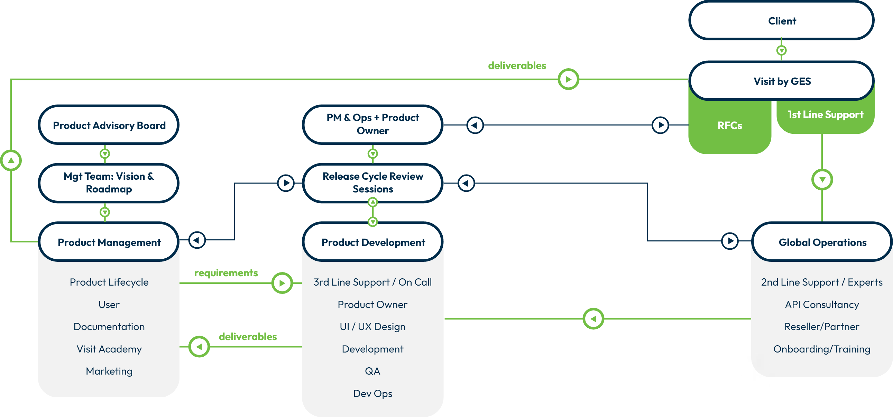
Executive Summary
Partnership
Commercials
Compliance
Demos & Workflows
Contact
DEMOS & WORKFLOWS
EI Workflow

Slide 25
Executive Summary
Partnership
Commercials
Compliance
Demos & Workflows
Contact
DEMOS & WORKFLOWS
Trusted Partner
Award Winning Tech
EN AWARDS
4 Best Supplier to Event Owners (2019)
4 Best Supplier to Exhibitions (2019,
2018, 2017)
ESSA AWARDS
4 Innovation of The Year (2018)
EN ELITE AWARDS
4 Best Registration (2017)
4 Best Tech (2017)
EVENT TECH AWARDS
4 Best Exhibition Tech (2017)
4 Best Visitor Registration Tech (2017)
MIDDLE EAST EVENT AWARDS
4 Supplier of the Year (2022)
AEO AWARDS
4 Innovation Award (2018)
4 Best Use of Tech (2018)
4 Supplier Team of the Year (2022)
4 Best Supplier of the Last 100 Years
UK GRAPHICS AWARDS
4 Innovation Award (2022)

Slide 26
Executive Summary
Partnership
Commercials
Compliance
Demos & Workflows
Contact
Contact Us
For more information, or to answer any questions you may have, please contact our GES Event Intelligence team:
Gerard Conway
Global Enterprise Director
GES EVENT INTELLIGENCE
David Cunningham
VP Product and Business Development
GES EVENT INTELLIGENCE
+44 (0) 7741 293 412
+44 (0) 7966 273 639
gerard.conway@ges.com
david.cunningham@ges.com

